Slide 1

Understanding the Global Impact of COVID-19: A Comprehensive Visualization and Analysis
Made by : Yossef Essam Fouad

Slide 2

Agenda
Introduction
Dataset Overview
Objectives
Data Analysis
Data Visualization

Slide 3
Introduction:
The COVID-19 pandemic has undeniably shaped the course of our world, impacting lives across continents. As we strive to comprehend the full scope of its effects, our analysis delves into a dataset encompassing worldwide excess deaths, providing a nuanced perspective on the pandemic's toll.
In this presentation, we embark on a journey through data visualization and analysis, utilizing a rich dataset sourced from Our World in Data. By exploring key metrics, trends, and correlations, we aim to unearth insights that contribute to a holistic understanding of the global landscape during these unprecedented times.

Slide 4
Dataset Overview:
Source: Our World in Data
Time Frame: 3rd January 2020 to 19th December 2023

Slide 5
Objectives:
Explore Key Metrics: Dive into the trends of total cases, total deaths, testing metrics, and vaccination coverage to comprehend the trajectory of the pandemic.
Correlation Analysis: Examine relationships between various factors such as stringency index, excess mortality, and total deaths to uncover potential patterns.
Geographical Insights: Investigate how excess mortality varies across continents and explore potential regional disparities.
Vaccination Impact: Assess the impact of vaccination efforts on the overall landscape, considering metrics like vaccination coverage and new vaccinations.

Slide 6

Data Analysis

Slide 7
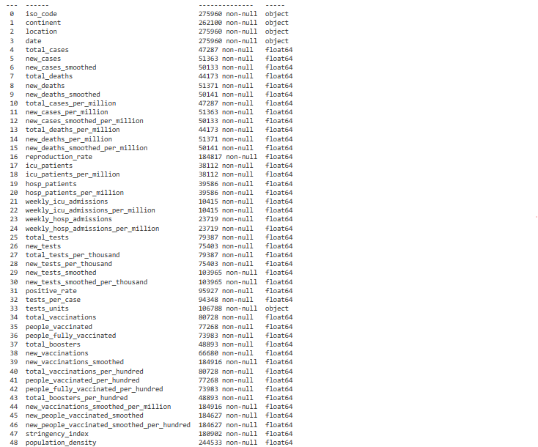
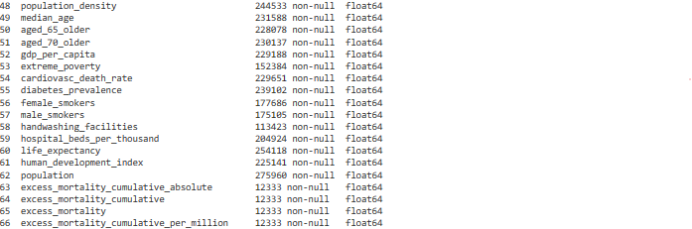
Data summary

Slide 8
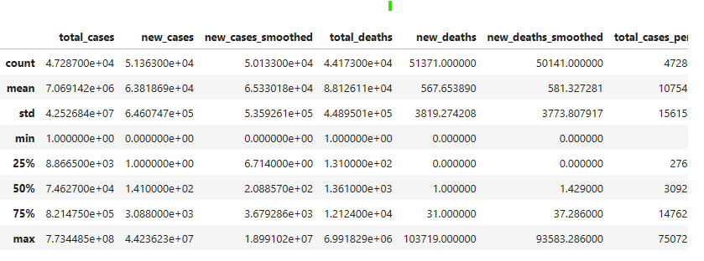
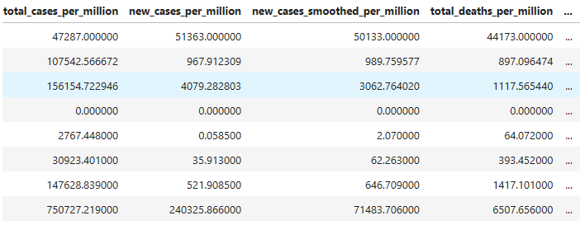
Summary Statistics

Slide 9

Data Visualization

Slide 10
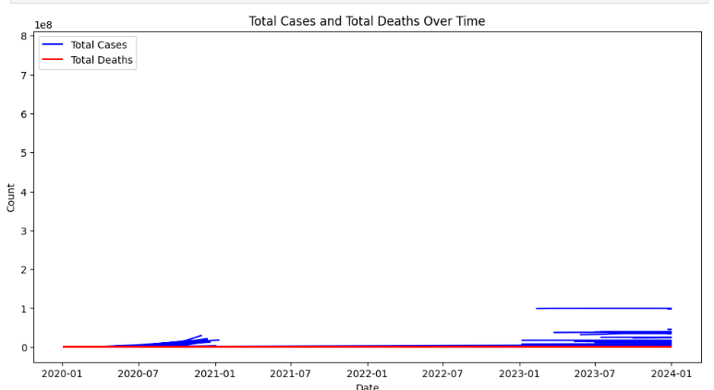
Total Cases and Total Deaths over Time

Slide 11
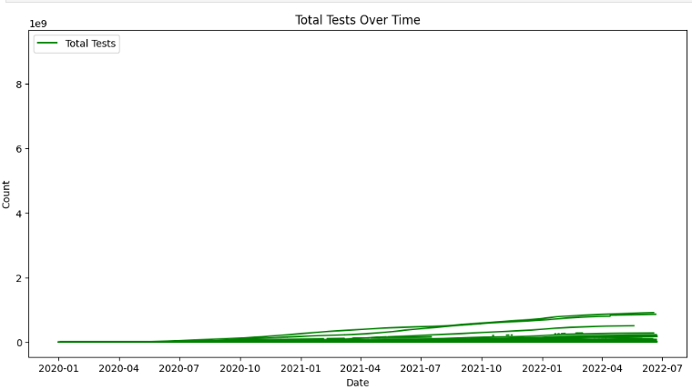
Total tests Over Time

Slide 12
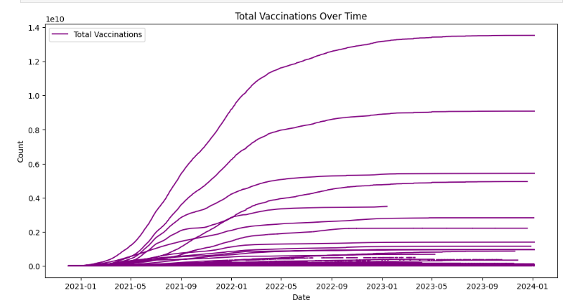
Total vaccinations Over Time

Slide 13
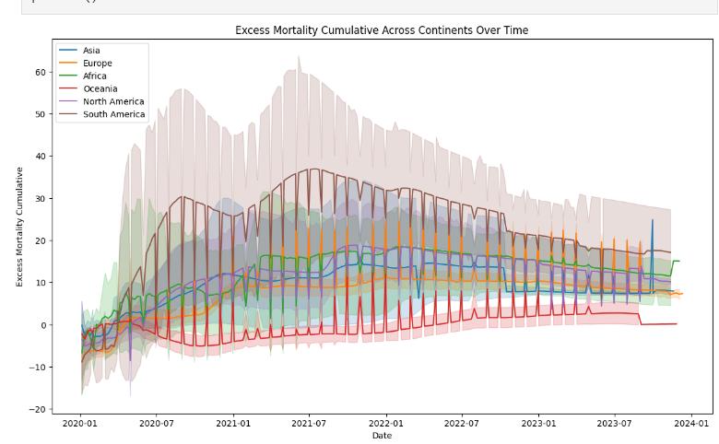
Excess morality cumulative Over Time

Slide 14
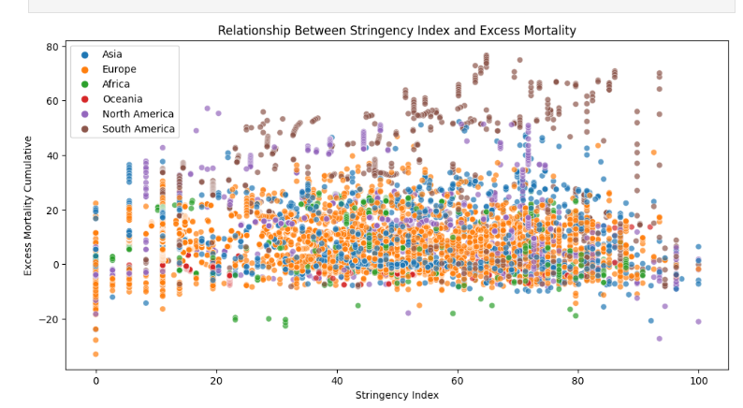
Relationship Between Stringency Index and Excess Mortality

Slide 15
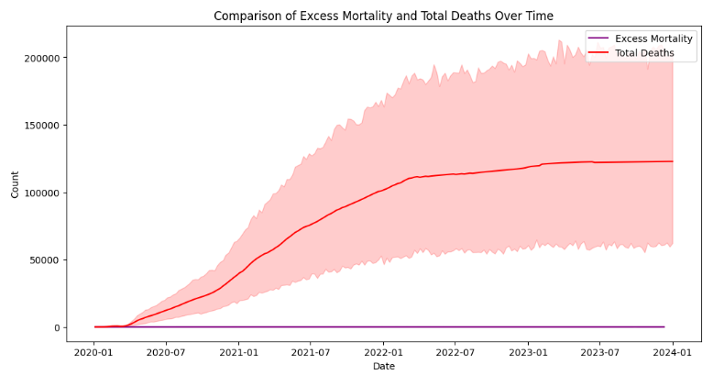
Comparison of Excess mortality and Total deaths Over Time

Slide 16
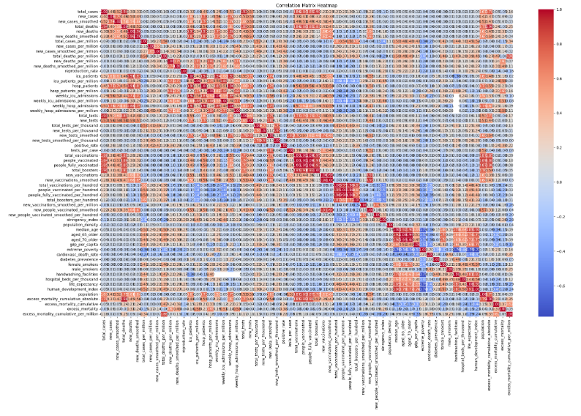
Correlation Matrix

Slide 17
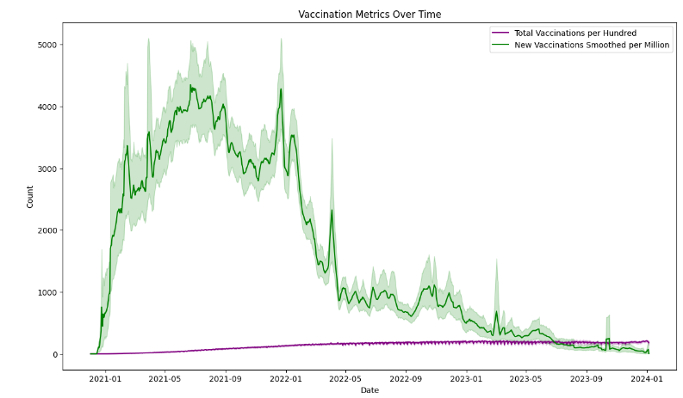
Vaccination metrics Over Time

Slide 18
You can find all the Analysis in github

Slide 19

Any Questions

Slide 20

Thank you

